Slide 1
Maximum Likelihood Is Meaningless
Presenter: Kim Seung Hwan (overnap@khu.ac.kr)

Slide 2

Maximum Likelihood
VAE optimizes $\log{p_{θ}(x)}$ - so what is this?
$p_{θ}(x)$ is likelihood: the joint probability of the observed data
Note that this is the function of the parameter $θ$
In other word, it is $p\left(θ | x\right)$; it means a function of $θ$when $x$ is fixed

Slide 3

Maximum Likelihood
Maximum likelihood is point estimation for best $θ$
VAE is also a type of it
What I would claim is that this is (almost) meaningless to generation

Slide 4
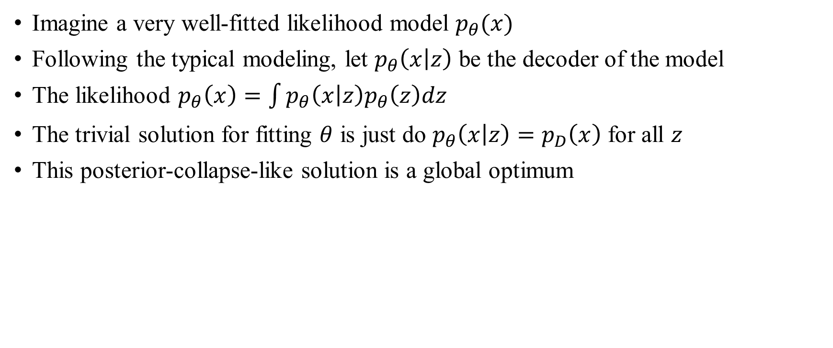
Maximum Likelihood Is Meaningless
Imagine a very well-fitted likelihood model $p_{θ}(x)$
Following the typical modeling, let $p_{θ}\left(x | z\right)$ be the decoder of the model
The likelihood $p_{θ}\left(x\right)=\int{p_{θ}\left(x | z\right)p_{θ}\left(z\right)dz}$
The trivial solution for fitting $θ$ is just do $p_{θ}\left(x | z\right)=p_{D}\left(x\right)$ for all $z$
This posterior-collapse-like solution is a global optimum

Slide 5
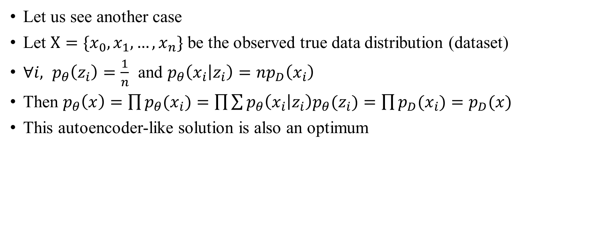
Maximum Likelihood Is Meaningless
Let us see another case
Let $X=\{x_{0}, x_{1},…, x_{n}\}$ be the observed true data distribution (dataset)
$∀i, p_{θ}\left(z_{i}\right)=\frac{1}{n}$ and $p_{θ}\left(x_{i} | z_{i}\right)=np_{D}\left(x_{i}\right)$
Then $p_{θ}\left(x\right)=\prod{p_{θ}(x_{i})}=\prod{\sum{p_{θ}\left(x_{i} | z_{i}\right)p_{θ}(z_{i})}}=\prod{p_{D}(x_{i})}=p_{D}(x)$
This autoencoder-like solution is also an optimum

Slide 6
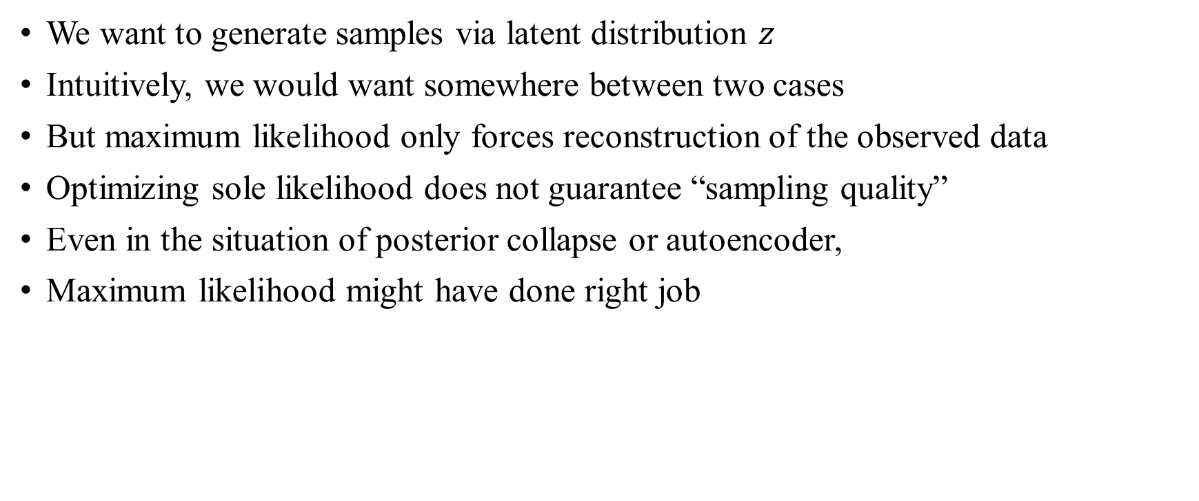
Maximum Likelihood Is Meaningless
We want to generate samples via latent distribution $z$
Intuitively, we would want somewhere between two cases
But maximum likelihood only forces reconstruction of the observed data
Optimizing sole likelihood does not guarantee “sampling quality”
Even in the situation of posterior collapse or autoencoder,
Maximum likelihood might have done right job

Slide 7
ELBO
Let us go back to the VAE
Optimizing the ELBO or even exact likelihood is a prerequisite
It just make for good reconstruction, but we also want sampling
Reconstruction may not even be necessary…

Slide 8

ELBO
VAE tried to obtain a generative model by fixing the prior $p(z)$ to gaussian
But the chosen loss, the likelihood, is neither more or less than reconstruction loss
It does not determine what will be sampled actually!
I believe beautiful sampling quality is a side effect of VAE implementation

Slide 9
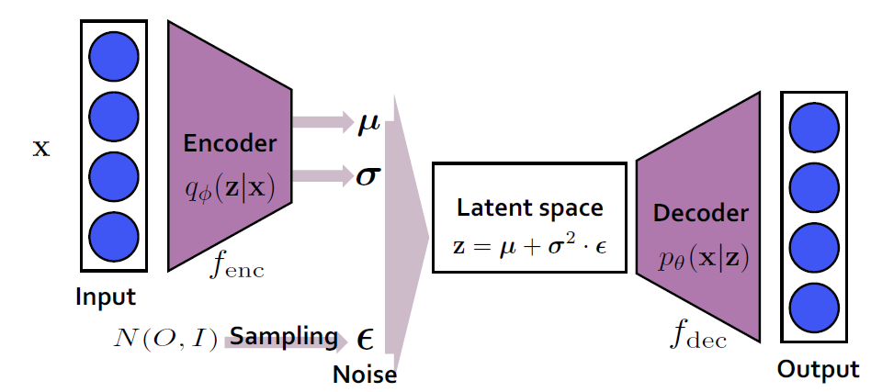
ELBO
Specifically, examples of elements of the implementation are:
Encoder is a diagonal covariance Gaussian model (this forces independence)
Decoder is a isotropic & constant covariance Gaussian model (to be desc. later)
Using CNN
etc.

Slide 10
ELBO
So, to summarize my claim:
Maximum likelihood only does reconstruction
Thus, VAE is a sample-able reconstruction model through variational inference
As for sampling quality, inductive bias does “everything.”

Slide 11
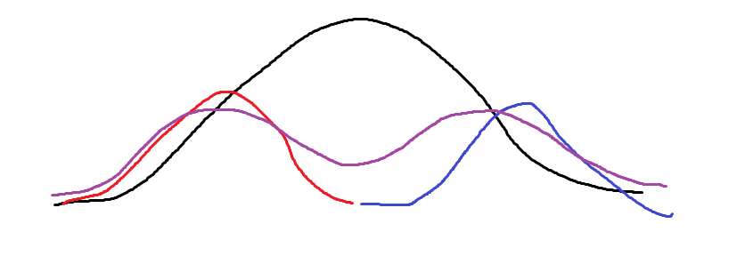




Experiments
As I said in my last presentation, I experimented with:
Increasing the sampling quality via diffusion-like method
I implemented a correct ELBO VAE as needed for sigma optimization
However, the performance of this model itself was not good!
Prior $p_{θ}(z)$
$$q_{φ}(z|x_{1})$$
Very unlikely point
(but often sampled)
$$q_{φ}(z|x_{2})$$
$$q_{φ}(z)$$

Slide 12
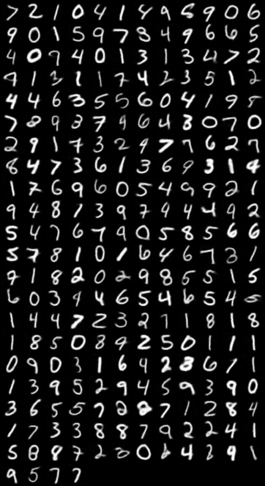
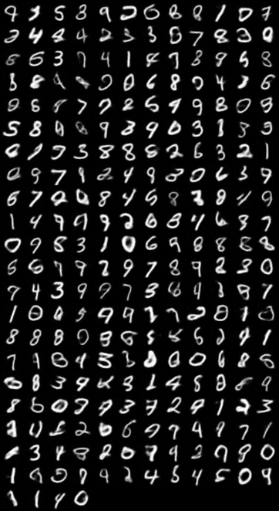
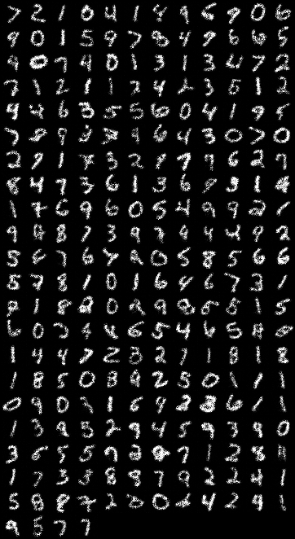
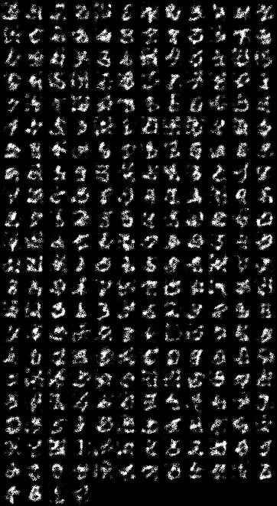
Experiments
Typical beta-VAE, recon (left) sample (right)
Exact ELBO VAE, sampling is very poor

Slide 13
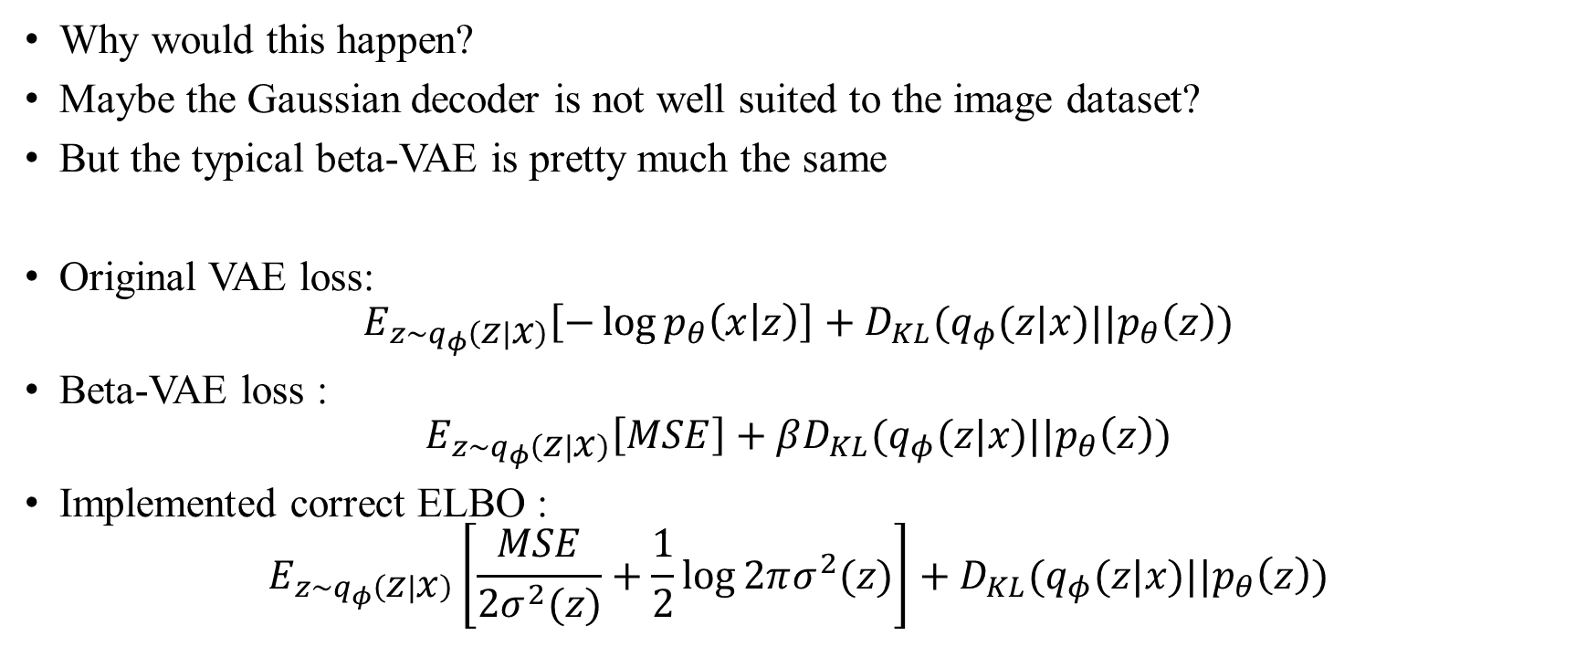
Experiments
Why would this happen?
Maybe the Gaussian decoder is not well suited to the image dataset?
But the typical beta-VAE is pretty much the same
Original VAE loss:
$$E_{z\sim q_{φ}\left(z | x\right)}\left[−\log{p_{θ}\left(x | z\right)}\right]+D_{KL}(q_{φ}(z|x)||p_{θ}\left(z\right))$$
Beta-VAE loss :
$$E_{z\sim q_{φ}\left(z | x\right)}\left[MSE\right]+βD_{KL}(q_{φ}(z|x)||p_{θ}\left(z\right))$$
Implemented correct ELBO :
$$E_{z\sim q_{φ}\left(z | x\right)}\left[\frac{MSE}{2σ^{2}(z)}+\frac{1}{2}\log{2πσ^{2}(z)}\right]+D_{KL}(q_{φ}(z|x)||p_{θ}\left(z\right))$$

Slide 14
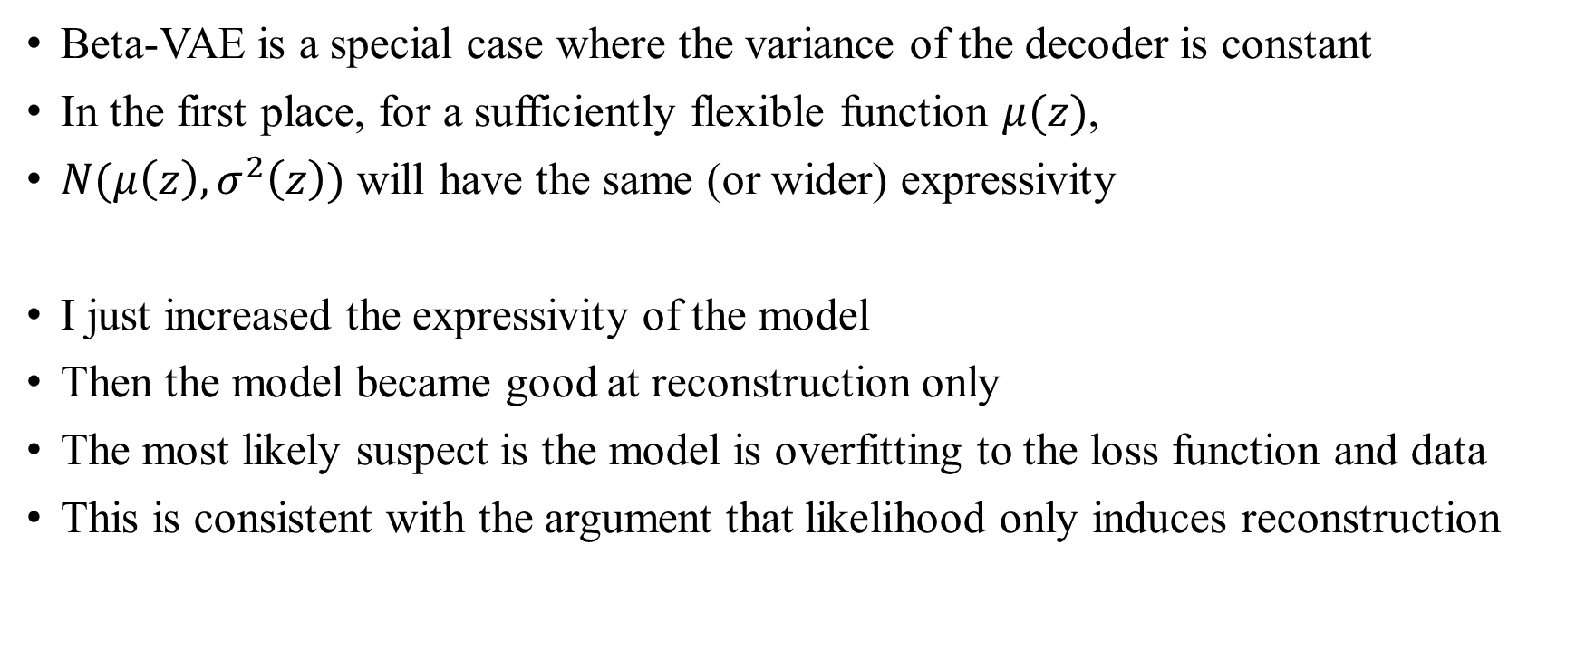
Experiments
Beta-VAE is a special case where the variance of the decoder is constant
In the first place, for a sufficiently flexible function $μ(z)$,
$N(μ\left(z\right), σ^{2}\left(z\right))$ will have the same (or wider) expressivity
I just increased the expressivity of the model
Then the model became good at reconstruction only
The most likely suspect is the model is overfitting to the loss function and data
This is consistent with the argument that likelihood only induces reconstruction

Slide 15
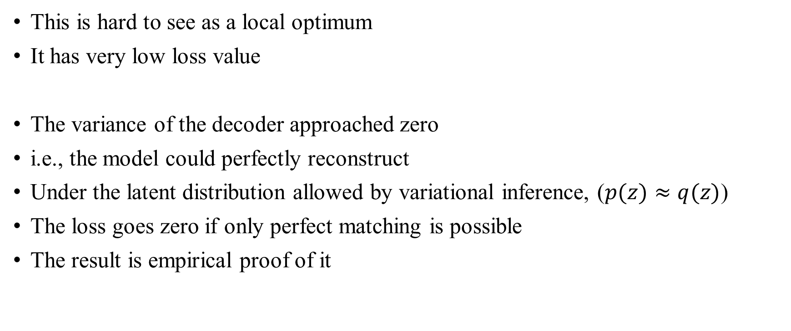
Experiments
This is hard to see as a local optimum
It has very low loss value
The variance of the decoder approached zero
i.e., the model could perfectly reconstruct
Under the latent distribution allowed by variational inference, ($p(z)≈q(z)$)
The loss goes zero if only perfect matching is possible
The result is empirical proof of it

Slide 16
Don’t blame the ELBO
This is the paper cited in my last presentation
My claim should blame a likelihood itself 😂
We do not have to be bound by ELBO or mathematical justification
What matters is the inductive bias
The success of other variants such as WAE seems to have originated here
“Unexpectedly, we show that spurious local maxima may arise even in the optimization of exact marginal likelihood, and such local maxima are linked with a collapsed posterior”
Lucas, James, et al. "Don't blame the elbo! a linear vae perspective on posterior collapse." Advances in Neural Information Processing Systems 32 (2019).

Slide 17
Don’t blame the ELBO
There are few previous works on this learnable decoder variance of VAE
They believed that an optimal variance exists
But I think it is correct that the variance goes zero if it is expressive enough
Rather, depending on how we define sampling quality,
We are looking for sub-optimal variance
I will try to explain previous studies through my claim

Slide 18
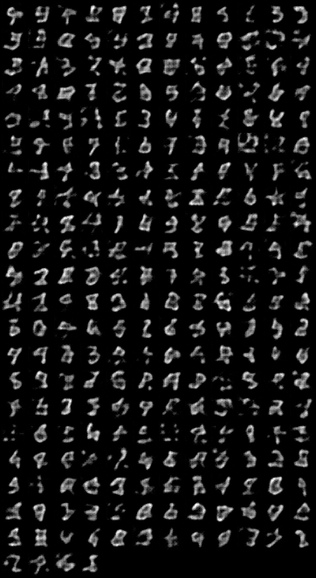
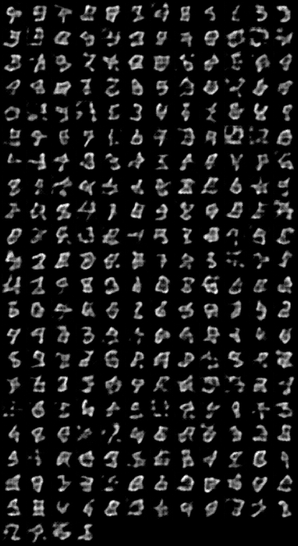

More Experiments

Slide 19
Thank you for listening
Presenter: Kim Seung Hwan (overnap@khu.ac.kr)

